Slide 1
Leukemia
By: Ashlynn Hill

Slide 2
Patrice Thompson
3 year who is battling leukemia.
The doctors suggest a bone marrow transplants for a long term survival.
Neither parents have matching bone marrows.
The parents consult with a genetic consoler and a reproductive specialist to discuss the possibilities of having another child to have matching bone marrow.

Slide 3
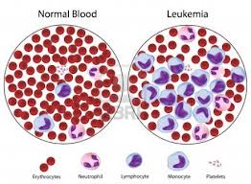
What is it?
It is cancer in the blood cells.
It starts in the bone marrow.
Leukemia is abnormal white blood cells, which are produced within the bone marrow.
They are not like normal blood cells. They grow faster then they should and do not stop growing when they should.

Slide 4
Problems it can cause
Overtime it can cause anemia, bleeding, and infections.
It can also spread to the lymph nodes and other organs, causing swelling and pain.

Slide 5
Are There Different Types?
ALL
Most common in children.
Acute Lymphoblastic Leukemia
Does not fight off infection very well
Gets worse more quickly
In adults and children, it causes: fever, weakness or feeling tired, bruising or bleeding easily, pinpoint spots under the skin from bleeding, bone pain, and loss of appetite.
AML
More common in men then women, occurs in children also.
Acute Myelogenous Leukemia
Acquired, not inherited.
Causes are unknown.
More common in children with Down Syndrome then any other disease.
In adults and children, it includes: weakness and fatigue, fever, night sweats, or a pain or feeling of fullness below the ribs.
Adults can have unexplained weight loss.
Children can have bleeding or bruising.
CLL
Chronic Lymphocytic Leukemia
Get worse more slowly than ALL and AML.
Occurs in adults in their 60’s.
Most common in men. Rarely seen in children.
CLL includes: weakness and fatigue, fever, night sweats, poor appetite, and weight loss.
CML
Chronic Myelogenous Leukemia
Gets worse more slowly.
It is more common in men then women.
It is commonly seen in adults in their 50; rarely seen in children.
CML includes: weakness and fatigue, fever, night sweats, poor appetite, and weight loss.
There are three phases: chronic phase, accelerated phase, and the blast crisis phase.

Slide 6
What causes it?
The causes are unknown.
There are risk factors which included:
Exposure to amounts of radiations.
Exposures to chemicals at work; such as benzene.
Chemotherapy as treatment to other types of cancer.
If you have Down Syndrome.
If you smoke

Slide 7
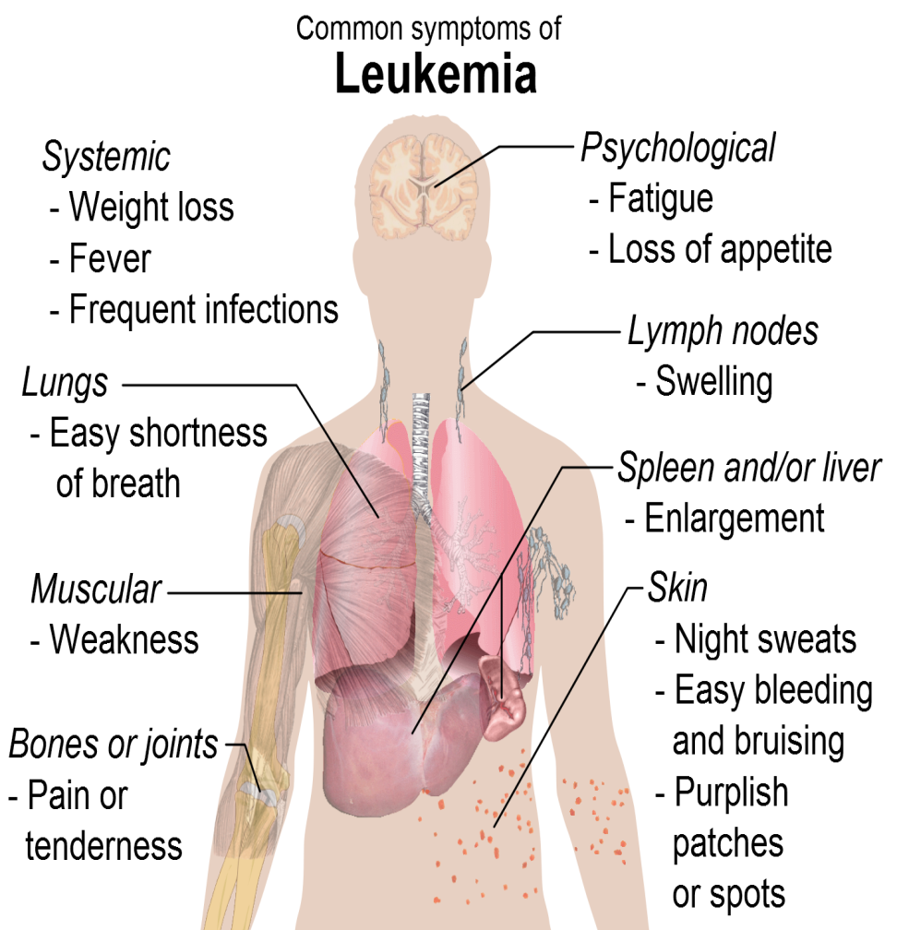
What are the symptoms?
Fever and night sweats.
Headaches.
Bruising or bleeding easily.
Bone or joint pain.
A swollen or painful belly from an enlarged spleen.
Swollen lymph nodes in the armpit, neck, or groin.
Getting a lot of infections.
Feeling very tired or weak.
Losing weight and not feeling hungry.

Slide 8
How do you diagnosis it?
The doctor will ask you questions about your health.
He will check to see if your spleen or lymph nodes are enlarged.
The doctor will also order blood tests to check your white blood cell count and if your other blood cell count is low.

Slide 9
How is it treated?
Chemotherapy
Kills cancers cells, also the most common treatment for leukemia.
Radiation Treatments
It is used to kill cancer cells and can shrink swollen spleens and lymph nodes.
Stem Cell transplant
This is used to try and build new red blood cells and to boost the immune system.
Biological Therapy
This is used to boost to body’s natural system against fighting cancer.
Clinical Trials are often used. Most leukemia patients do this to test new medicines.
If you have acute (ALL or AML) you need quick treatment to stop the rapid growth of cells.
Usually the cancer goes into remission.
Doctors prefer remission over cure because of the chance that it will come back.
If you have chronic (CLL 0r CML) it is rarely cured but can use treatment to control the disease.
CML is usually treated right away.

Slide 10
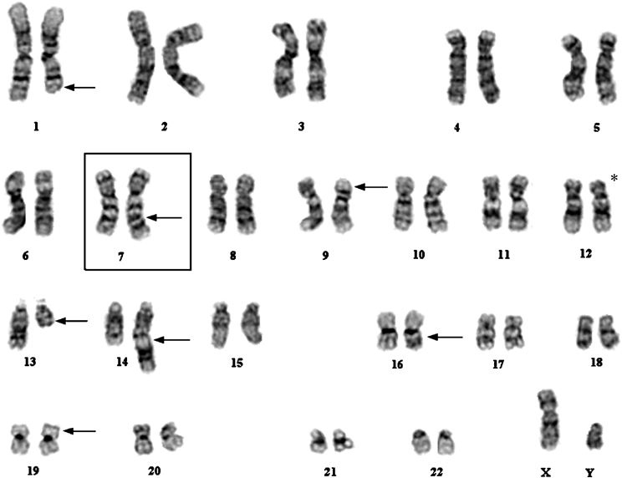
Karyotype

Slide 11
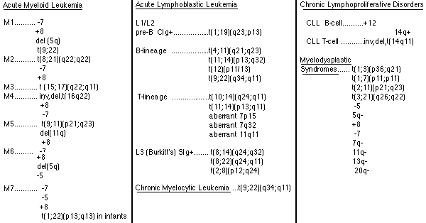

Slide 12
Recommendation
As a genetic consoler, I would recommend that Patrice gets a stem cell transplant after chemotherapy. I would suggest getting bone marrow from a volunteer who has a matching stem cell, so that way their hopes are not held high with the possibility to be disappointed of having another offspring.

